Slide 1

Charging for Expertise
Introduction
Your technical skills can be the foundation of a new business – one that you own and operate!
Entrepreneurship education is important because:
It helps you think of new ways to earn money in a tough economy.
It can help prepare you for a job.
It can help you think of new ways to be a valued employee in any job.
It demonstrates a variety of ways that your technical skills can be used in the workplace.
It creates a foundation for additional learning experiences.
Notes:
Introduction
Pacing Guide:
It will take approximately 45 to 60 minutes to complete the case study.
It will take approximately 1 to 2 hours to complete the lab.
Script:
Did you know that almost every developed country in the world, and many of the developing countries, have a government office dedicated solely to increasing entrepreneurship within their borders?
Why is entrepreneurship so important to all these countries, and why are we studying it in a Networking Academy course? Because with the ever-changing economy you need to be prepared to recognize interesting and challenging employment opportunities everywhere!
Discussion Questions:
Is anyone in this class operating their own business?
Does anyone know an entrepreneur? What is their business?
Supplementary Activities/Materials: N/A

Slide 2
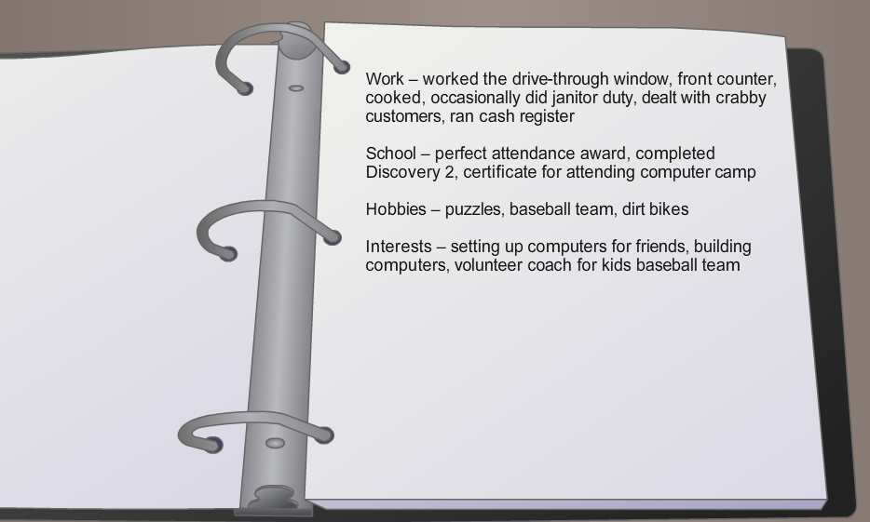
Charging for Expertise
Section 1
Recognizing Expertise
Skills have value in the marketplace.
Evaluating the skills you already have can lead to an idea for a new business
Knowing your skill set can help you in a job interview.
A business idea is not always a good business opportunity. It must be researched to determine if there is a market for the product or service.
Entrepreneurs contribute to their communities through their business operations.
Notes:
Section 1: Recognizing Expertise
Script:
Everyone has at least one skill that can become the foundation for a new business.
You are learning skills right now that are valuable.
How can you take these skills and create a small business? You can research the environment around you and determine who needs the skills you can provide.
Discussion Questions:
1. How can knowing your strengths and weaknesses help you in a job interview?
2. What are a few ways a business contributes to the community?
Supplementary Activities/Materials:
Have students contribute to a class discussion listing the skills that they acquire through the Discovery course.
Activity Answers Page 1.1.3.5:
Sole Proprietorship – A writer who produces business newsletters.
Partnership – Two brothers who are starting a landscaping business.
Corporation – A manufacturer who plans to sell equipment to different industrial sites across the country.
Non-profit Corporation – A museum for regional pottery and crafts.
Cooperative – A group of home-child-care providers who want to purchase and share baby supplies.
Lab: N/A

Slide 3
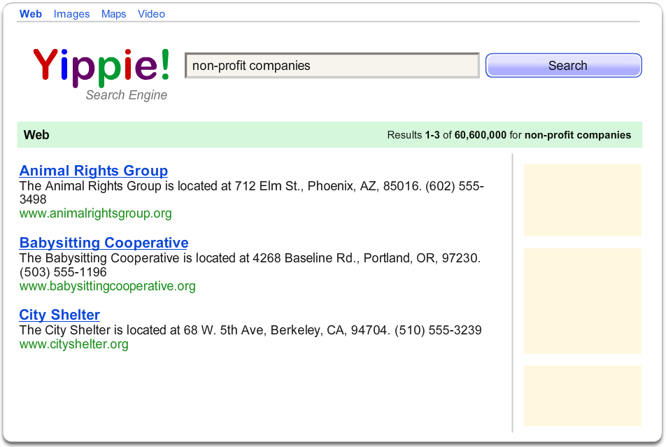
Charging for Expertise
Section 2
Generating Income
Find the people who need the skills you have.
Entrepreneurs use research to help them locate the people who need their product or services. These people are their target market.
Communicating to the target market is called “marketing.” Asking them to purchase the product or service is called “selling.”
Entrepreneurs sell by showing the customer the benefits they will receive when they purchase the product.
It takes money to research, communicate, and sell to a market. Entrepreneurs usually need financing to open and operate their business.
Notes:
Section 2: Generating Income
Script:
It’s not enough to have a great idea. A business can’t exist unless people want to purchase the product or service. Finding the people who need your product takes research. You must communicate with them to know what they need and tell them you have a product that can help.
Sales of the product provides the company with money to continue to operate. But, sometimes a company needs money just to begin the business or to help during times when sales are slow. Entrepreneurs look for investors to help provide funding for their business. Think about who might invest in your business.
Discussion Questions:
Who might be the target market for a new computer repair shop?
What are the features and benefits of the computer you are working with?
Supplementary Activities/Materials:
Invite a speaker from the business department.
Activity Answers: N/A
Lab: N/A

Slide 4
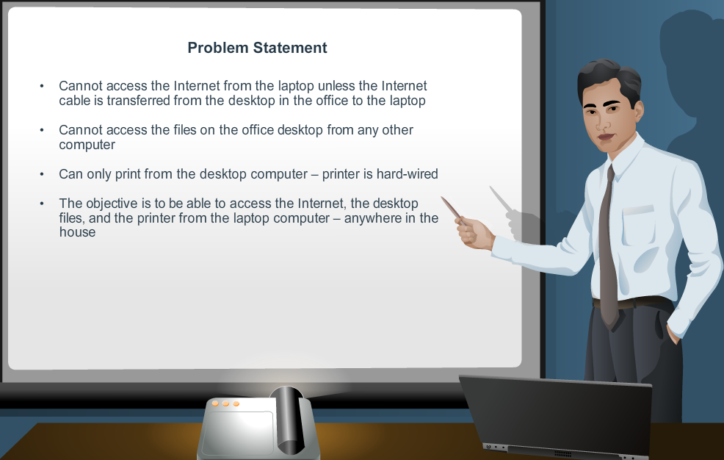
Charging for Expertise
Section 3
Creating a Presentation
Presenting yourself and your ideas in a professional manner is key to success.
A written presentation organizes ideas and helps minimize misunderstandings
How you present yourself is as important as the ideas you are presenting
Notes:
Section 3: Creating a Presentation
Script:
We are constantly presenting ourselves and our ideas to classmates, co-workers, parents, children, teachers, bosses, - the list is endless. How you make these presentations can determine the success or failure of your project.
Discussion Question:
What are a few presentations we make everyday? (asking questions in class, trying to get your classmates or co-workers to cooperate with an idea…)
Supplementary Activities/Materials:
Look for active listening signals from your classmates.
Activity Answers: N/A
Lab Page 1.3.2.4
Download answers to lab. Filename: ReviewSalesPresentation_1324 (instructor).pdf

Slide 5

Charging for Expertise
Section 4
Keeping Good Records
Accurate records help an entrepreneur evaluate the business.
Records are only good if you can access them. Organizing both paper and electronic files is important.
Securing records is always smart business.
Notes:
Section 4: Keeping Good Records
Script:
Records provide a history of our business. Evaluating what has happened in the past helps entrepreneurs in many ways. They can see which areas of the business are performing well and which need help. Accurate records can also help them predict what might happen in the future. This is critical in planning what resources they will need.
Discussion Questions:
Can you think of any records you should be keeping? (school expenses, log of grades, personal expense log…)
What are some uses for the records you keep? (help prepare taxes, keep up with how you are doing in class, help budget your money…)
Supplementary Activities/Materials:
Keep a log of everything you spend for one week.
Activity Answers: N/A
Lab: N/A

Slide 6

Charging for Expertise
Section 5
Giving Good Customer Service
Getting, and keeping, customers is the only way a business can continue to operate.
Everyone in an organization is involved in customer service.
Keep a “customer first” attitude.
Handle conflicts professionally.
Gain customer loyalty.
Notes:
Section 5: Giving Good Customer Service
Script:
Think of times you got really good or really bad service. Did you return to the company? Did you tell anyone else about your experience? Customers are the best source of advertising a business has. Keeping them happy and giving them incentives to return is key to the success of the business.
Discussion Questions:
Do you belong to any customer retention programs?
Supplementary Activities/Materials:
List all the customer retention programs you can think of in the next three minutes.
Activity Answers: N/A
Lab: N/A

Slide 7
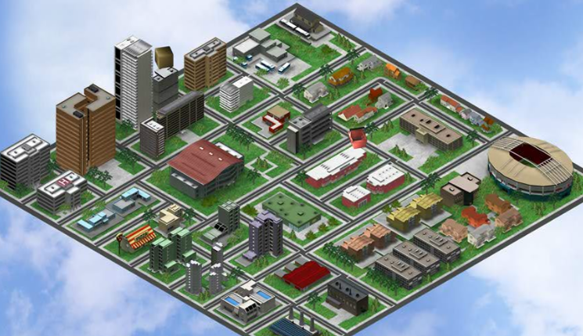
Passport21 to
Entrepreneurship
The case study characters adventure outside their normal routine to discover new opportunities in entrepreneurship.
Along the way they:
Recognize new business ideas
Learn new business terms
Use the decision-making process to reduce risk
Research and evaluate options to decide on the best opportunities.
We hope you enjoy their journeys.
You can interact with the characters through the Aspire interactive game. There is a link to the game on your student home page.
Have fun!

